Slide 1
LinkedIn Grad
Design Sprint
Product Manager: Bich Pham
© 2019 Udacity. All rights reserved.

Slide 2
Set the stage
Set the stage for the Design Sprint by framing the problem
© 2019 Udacity. All rights reserved.
Notes:
[ALL PARTICIPATION]

Slide 3
Initial PRD
Link

Slide 4
Understand
Create a shared understanding of the space, problem, and goals
© 2019 Udacity. All rights reserved.
Notes:
[ALL PARTICIPATION]

Slide 5
How Might We
Use these digital stickies to capture your ideas. Feel free to rearrange. Colorize. Etc
How might we provide suitable CV template regionally
How might we apply AI in the review process for resume and suggest jobs
How might we provide a profound knowledge for freshers
How might we improve soft skills for students
How might we guide students to their correct career paths
How might we partner with college career centers?
How might we suggest profile to recruiters
How might we create an attractive profile

Slide 6
Sorted Stickies
Link

Slide 7
Sprint Focus
Focus | Tools and services
Slide # | Slide 1
I selected this theme because | The primary reasons is the core feature. This theme brings several values to graduated students. It could be one of the initial features. (Resume Help)

Slide 8
Define
With an understanding of the problem space, create focus and align on specific outcomes for the Design Sprint
Notes:
[ALL PARTICIPATION]

Slide 9
Project Review/Future Press Release
LinkedIn Grad would the excellent tool which you can use in the era of data and digital information.
This product helps me figure out my expected job as well as provide the suitable career path for them. By using the AI systems, I could effortlessly own my resume and it could be reviewed to adapt well with the professional requirements from recruiters. Furthermore, the application would provide online courses to help me improve interview, negotiation, and presentation skills that need preparing before any job interviews in businesses. Signup and upgrade membership to get the sufficient of features.
LinkedIn has already have millions of users including recruiters, leaders, and managers from many enterprises all over the world; therefore, it could be convenient for me to find the expected jobs and explore the network. In the community, I have chance to study and express myself
In conclusion, user would love this application and use it to find jobs as well as signup premium to access all excellent features

Slide 10
Success Metrics
 | Goals | Signals | Metrics
Happiness | Users are pleasurable with the features | - Interview - Survey - Rate from market (app store,play store) | - Score
Engagement | Users continues signup and interact in app | - CV created - Time online - Certificate taken | - Average using time (weekly) - Active users (monthly)
Adoption | New users value and introduce to others | - downloads app - signup | - Conversion rate
Retention | Users continue to use the feature | - CV created - upgrade membership | - churn rate - renew rate
Task Success | Users get jobs and knowledge | - jobs offers - profile suggest - certificate gained | - average of applications for jobs

Slide 11
Sketch
Generate tons of ideas, then narrow them down to two in depth solution sketches
Notes:
[ALL PARTICIPATION]

Slide 12
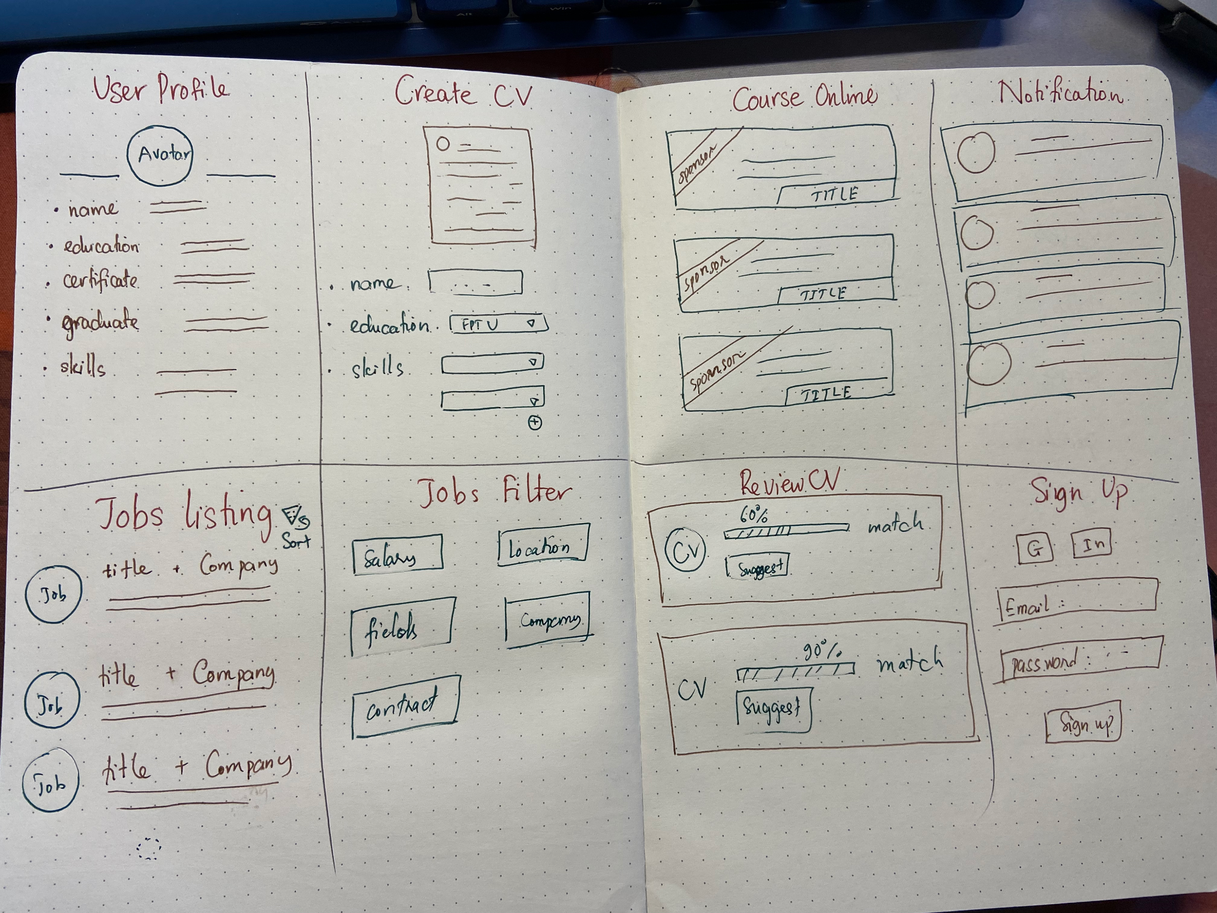
8 Sketches

Slide 13
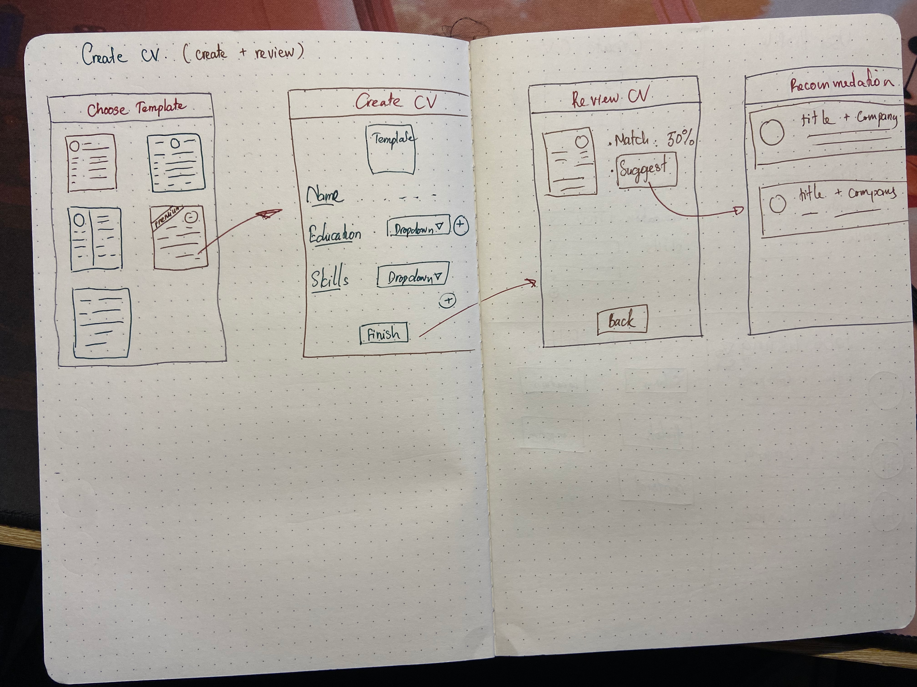
Solution Sketch 1

Slide 14
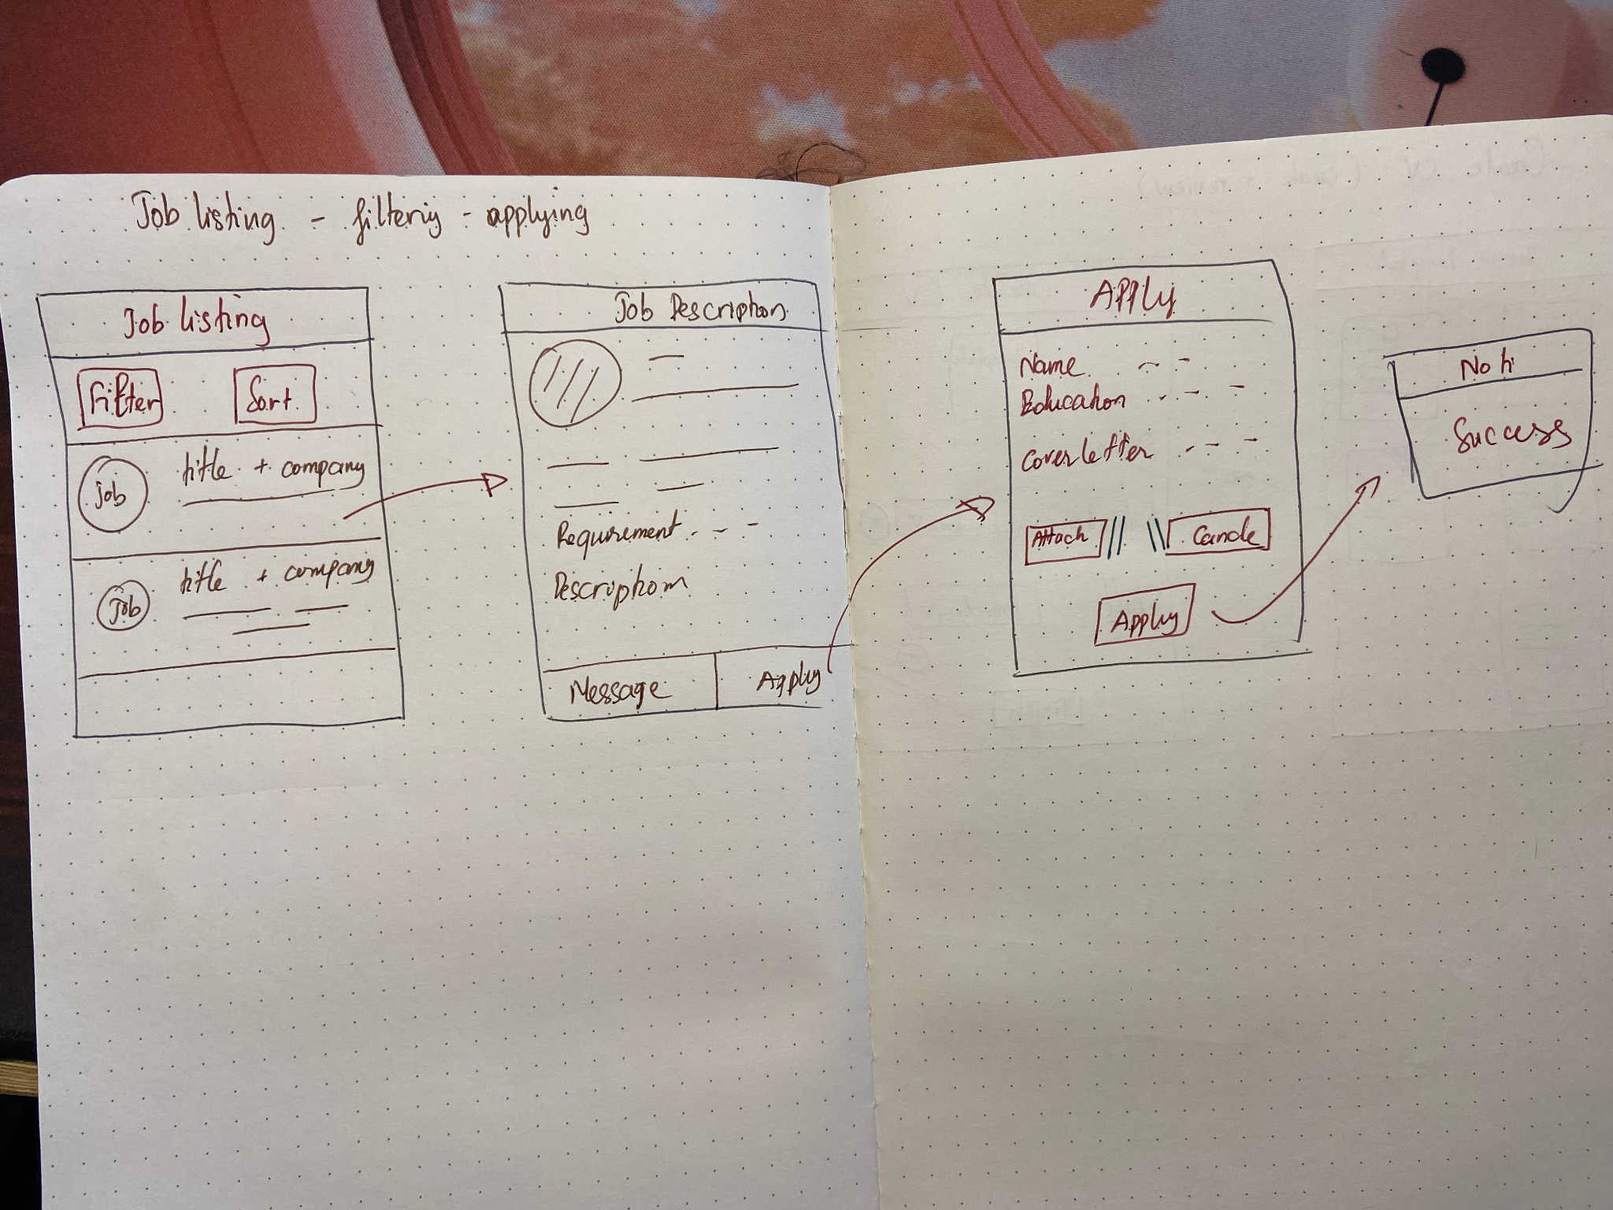
Solution Sketch 2

Slide 15
Decide
Pick the final concept that you develop into a prototype
Notes:
[ALL PARTICIPATION]

Slide 16
Decision
Decision | Create CV (Sketch 1)
Rationale | This sketch is the most fundamental and essential step before applying any jobs. An excellent resume would prove the potential job for applicants

Slide 17
Prototype
Turn your concept into a realistic, interactive prototype that you will use to validate your assumptions and ideas
Notes:
[ALL PARTICIPATION]

Slide 18



Storyboard
Script: Anna is an excellent students in computer science and graduated 6 months. She could not get the any suitable job because of being rejected resume
Action: Anna is really stressful and frustrated due to the costs of living and no career path | Action: She found the LinkedIn Grad through a community of students in her previous university. | Action: Download and register membership
Script: Anna downloaded and registered the app and memberships. She could create CV that matches with the expectation from recruiters
Script: Anna surf internet to figure out the solutions. However, there are two many jobs but she could not find the suitable reason for the rejections

Slide 19



Storyboard
Script: Anna immediately create the CV by using AI guidance in LinkedIn Grad. | Script: She waited for the review from the system and get the suggestion | Script: She applied and got the call from recruiters for preparing the job interview
Action: Create CV | Action: Review CV | Action: Apply job

Slide 20
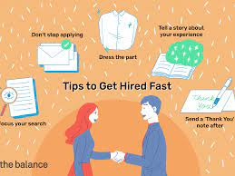
Storyboard
Script: Anna finally found her dream jobs with suitable benefits
Action: Get job

Slide 21

Prototype
Description High level overview of the prototype What does it do? | This prototype shows how to signup/login LinkedIn Grad. User could create their own resume and system would review them automatically. Users would receive the list of suitable jobs for their future apply.
Assumptions Any assumptions within the prototype | User registers and has LinkedIn Grad account User select the template CV User fill the required information to complete CV User receive the review and access jobs recommendation from AI system
Tasks What are the tasks that a user can complete in the prototype? | Signup/Login app View their profile => create their own CV Choose the resume template Complete CV Review from System Get job recommendation
Link

Slide 22
Validate
Users will go through your prototype and provide feedback on your concept. This is also an opportunity to have an engineering feasibility discussion
Notes:
[ALL PARTICIPATION]

Slide 23
[LinkedIn Grad] Research Plan
PM: Bich Pham
STATUS: DRAFT
Objectives
The assessments from recruiters and graduated students about the ideas of LinkedIn Grad
Methodology
Survey
Direct interview
Participants
1 senior recruiters (IT section)
1 graduated students (IT University)

Slide 24
[LinkedIn Grad]: Interview Sessions
Link

Slide 25
User Testing: Participant 1 Key Findings
Note
Audio
What worked well | User found Job recommendation and CV creating are really essential to help them handle with many problems because of lack of experience User liked the match of system while comparing CV and expectation from recruiter
Where participants got stuck | User do not understand the process of applying jobs
Other observations | User enjoy creating CV and appropriate the result from AI if it’s true

Slide 26
Participant 1: Interview Notes
- Participant has 5 years of experience in hiring people
- CV is really important because it is the first step in the process
- Soft skills like negotiation and presentation play an essential role in business
- Should add more features in the next phrase like messaging or apply jobs
- The recruitment process involves many steps like CV, phone screening, interview, test,...
- Technical skills sometimes prevent freshers from getting an expected jobs

Slide 27
User Testing: Participant 2 Key Findings
Note
Audio
What worked well | User like the idea of create CV by AI that help them filter CV effectively User focus on the way of assessment from AI
Where participants got stuck | User don’t find the feature for employers Need to update templates
Other observations | User suggest add certificate in the process of creating CV

Slide 28
Participant 2: Interview Notes
- Attitude is really important in the interview round => soft skills
- Resume is the background of students => fundamental requirements
- Participant has a part time job => want to join tourism company after graduation
- The test after interview could effect on the result
- Everything designed is perfect
- Need to develop more features like messaging, applying => next phrase

Slide 29
Improvement
Improvement 1 | Add certificate automatically in CV and allow students to independently upload Boost the quality of CV Clear the information for recruiters Diverse the knowledge of users
Improvement 2 | Invest on AI algorithm Increase the users’ trust Emphasize on the quality of hiring process

Slide 30
Handoff
© 2019 Udacity. All rights reserved.
Notes:
[ALL PARTICIPATION]

Slide 31
Updated PRD
Link

